Slide 1
Function

Slide 2

Function Declaration

Slide 3
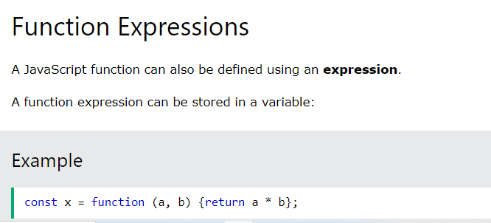
Function Expression

Slide 4
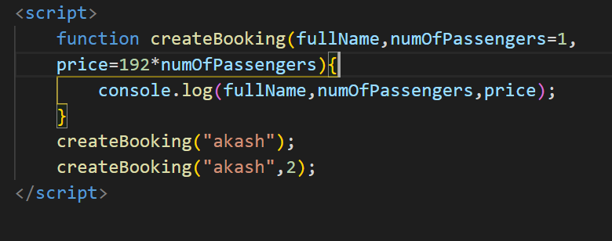
Default Function Parameters

Slide 5

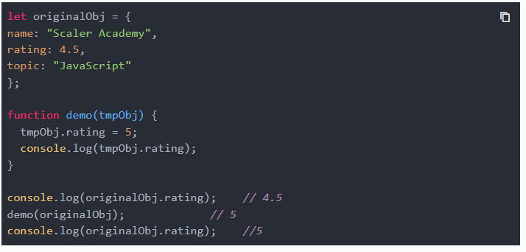
Function Value Vs Function Reference

Slide 6
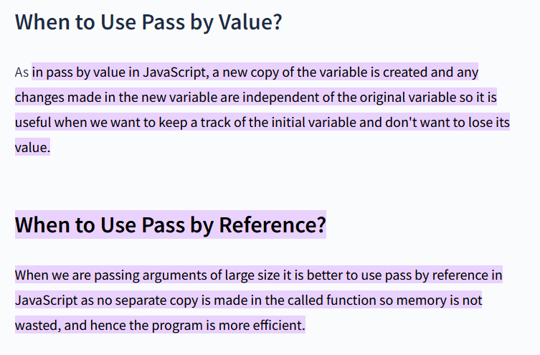
Function Value Vs Function Reference

Slide 7
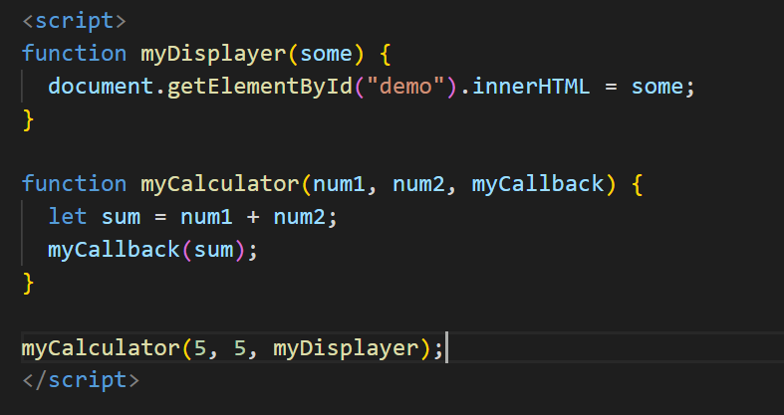
Function Callback

